Slide 1


LINUX

Slide 2
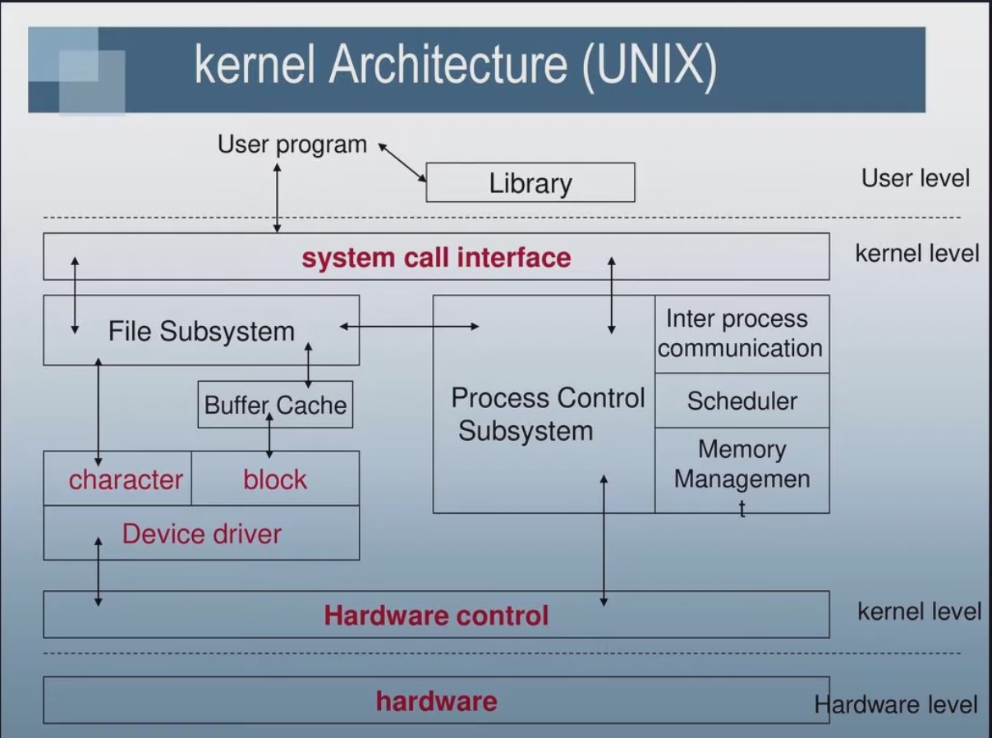
Kernel

Slide 3
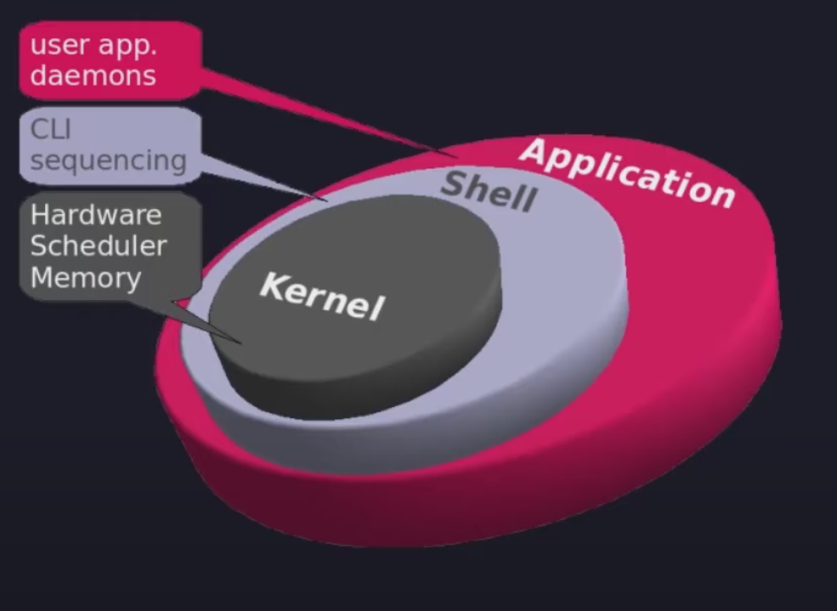
Kernel, Shell, App

Slide 4
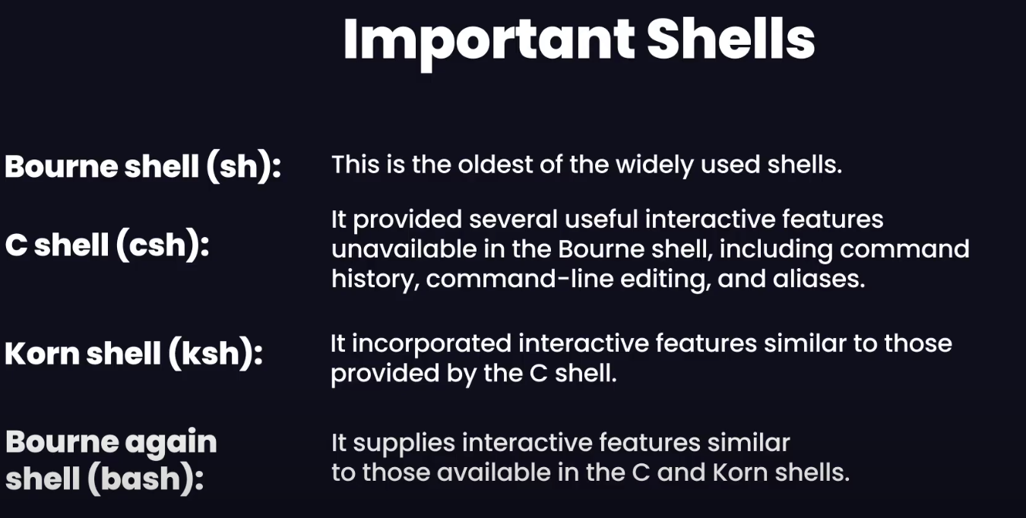
Shell
Prog designed to read commands typed by user & execute it.
Apart from interactive views it helps in Interpretation of shell scripts which are text wise containing commands.
Bourne again shell(csh + ksh) – mostly used
For e.g: Login shell – denotes process that is created to run shell when user first logs in.

Slide 5

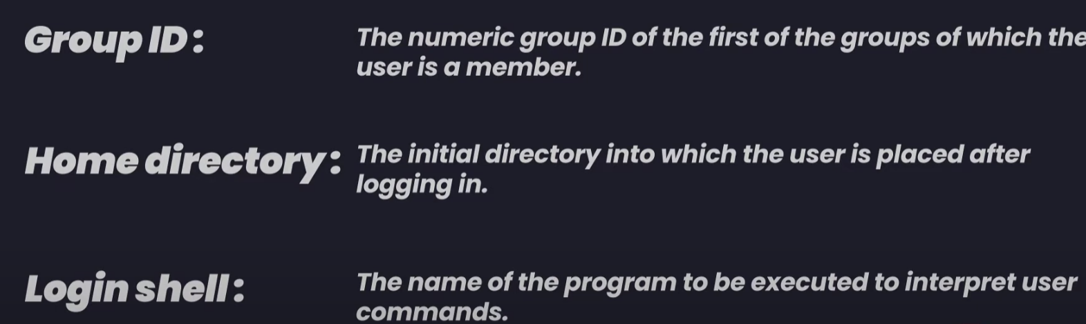
User - /etc/pwd
Login – login shell used Each user is uniquely identified and they may belong to a group.
User has uid and pwd stored in /etc/pwd file. This file have more info:

Slide 6
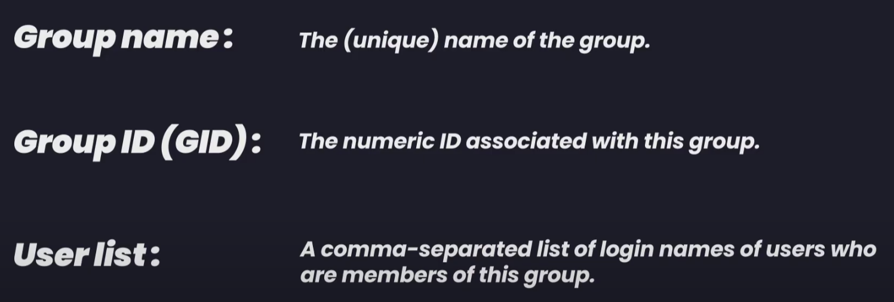
Groups - /etc/group
For administrative purpose its better to organize user into groups.
Early UNIX: originally, a user could only belong to one group at a time. This meant group-based permissions (read/write/execute) were very limited.
BSD’s role: BSD (Berkeley Software Distribution) extended this model by allowing a single user to belong to multiple groups simultaneously.
This was a big improvement because it enabled finer-grained access control.
For example, a user could be in projectA group and projectB group at the same time, accessing files/resources belonging to both.
It became the foundation of the group membership model that modern UNIX/Linux systems use today.
📌 In practice, group membership is stored in /etc/group. Each line lists the group name, ID (GID), and members. With BSD’s change, a user could appear in multiple entries.
👉 So the role of BSD here: it introduced multi-group membership for users, making the permission model more flexible and powerful — something inherited by Linux and other UNIX-like systems later.
Each group is identified by a single line in in system group file. File path etc/group
Group file also has more info:

Slide 7
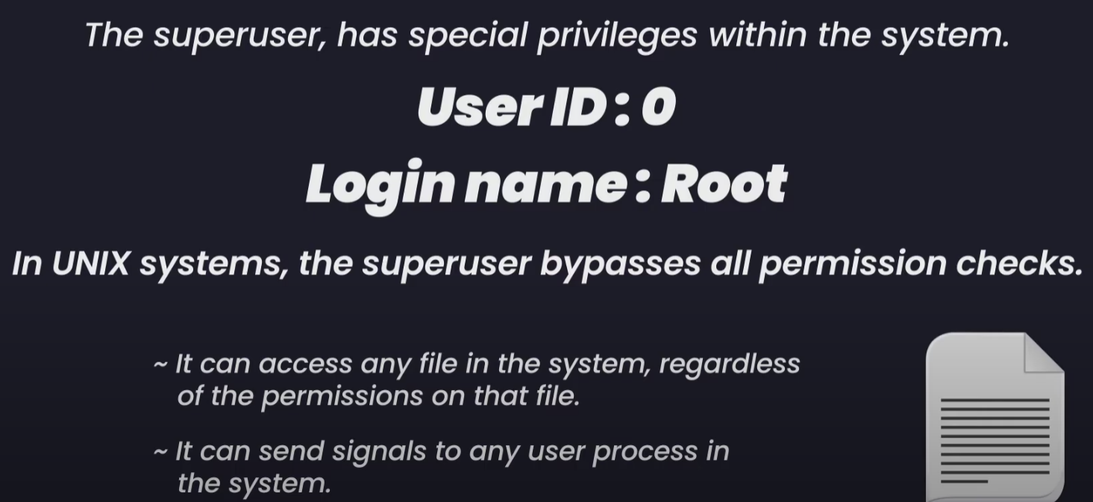
Superuser(root)
Where is the password stored ? – in separate shadow pwd file(encrypted) which is readable only by privileged users i.e. superusers or shadow groups.
On modern UNIX/Linux systems, encrypted (hashed + salted) passwords are stored in the separate file /etc/shadow, which is readable only by privileged users such as root. /etc/passwd remains world-readable but contains only placeholders for the password field.
Note: hashing works (like salts, algorithms: DES, MD5, SHA-256, SHA-512, bcrypt)

Slide 8
Shadow file - /etc/shadow
1. Is shadow a directory?
❌ No.
/etc/shadow is not a directory, it’s a plain text file.
Location: /etc/shadow.
Purpose: store username + hashed password + password aging rules.
2. What does “group = shadow” mean?
ls -l /etc/shadow
You’ll typically see something like: -rw-r----- 1 root shadow 1550 Sep 13 12:00 /etc/shadow
Owner: root
Group: shadow
Permissions: rw- r-- ---
This means:
Root can read & write.
Anyone in the shadow group can read the file.
Others have no access.
3. Who is in the shadow group?
Regular users are NOT in this group.
Instead, system programs that need to verify passwords (system daemons - like login, sshd, su, PAM modules) are given the ability to run with group shadow. (Acces to shadow file)
This lets them read /etc/shadow to fetch the hash → then they hash the password you typed and compare.
⚠️ If a normal user were added to shadow group, they could steal everyone’s hashes and crack them offline. That’s why it’s tightly controlled.
Note: System daemons –
System daemons are background processes (services) that the OS starts, not directly tied to a user’s shell/terminal.
They often run with root or special group privileges (like shadow) so they can read /etc/shadow to verify your password when you log in.
Examples: sshd → handles SSH login, login → checks passwords at console login, cron → runs scheduled jobs, systemd → manages services
system daemons act as the middlemen that verify your password against /etc/shadow.

Slide 9
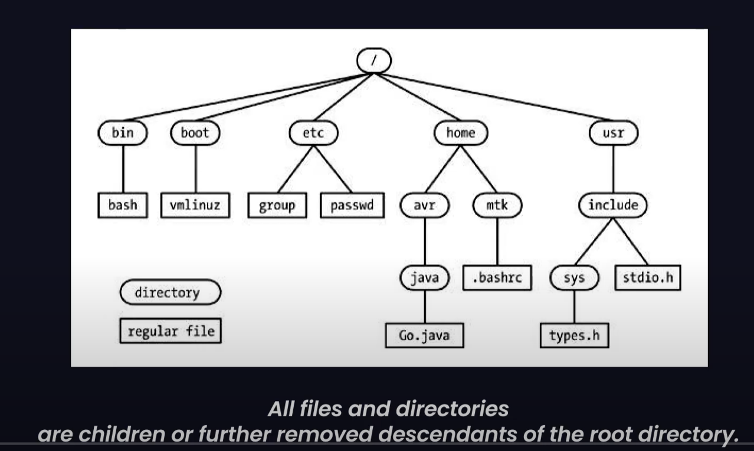
Directories, links and files

Slide 10
File Types
Each file is marked with a type, indicating what type of file it is.
1.Regular or plain files(-) –> denotes ordinary data file. Examples include text files, executable programs, images, videos, and archives. They can store information in either human-readable (ASCII) or binary format.
2. Directory Files(d) - Directories act as containers for other files and subdirectories, organizing the file system hierarchy.
3. Symbolic links(l) - Also known as soft links, these are pointers or shortcuts to other files or directories. They contain the path to the target file or directory.
4. Devices files - These represent hardware devices and allow interaction with them.
- Block Device Files (b): Represent devices that transfer data in fixed-size blocks, such as hard drives, SSDs, and CD-ROMs. They typically provide buffered access.
- Character Device Files (c): Represent devices that transfer data character by character, like keyboards, mice, and printers. They usually provide unbuffered access.
5. Pipes files(p) - Also known as FIFO (First-In, First-Out) files, these facilitate inter-process communication (IPC) by allowing one process to write data to the pipe and another to read from it in a sequential manner.
6. Sockets files(s) - These enable communication between processes, either on the same machine (Unix domain sockets) or across a network (network sockets). They are commonly used for client-server applications.
If we do ls –l, then we can identify the file type by the abbreviation.

Slide 11
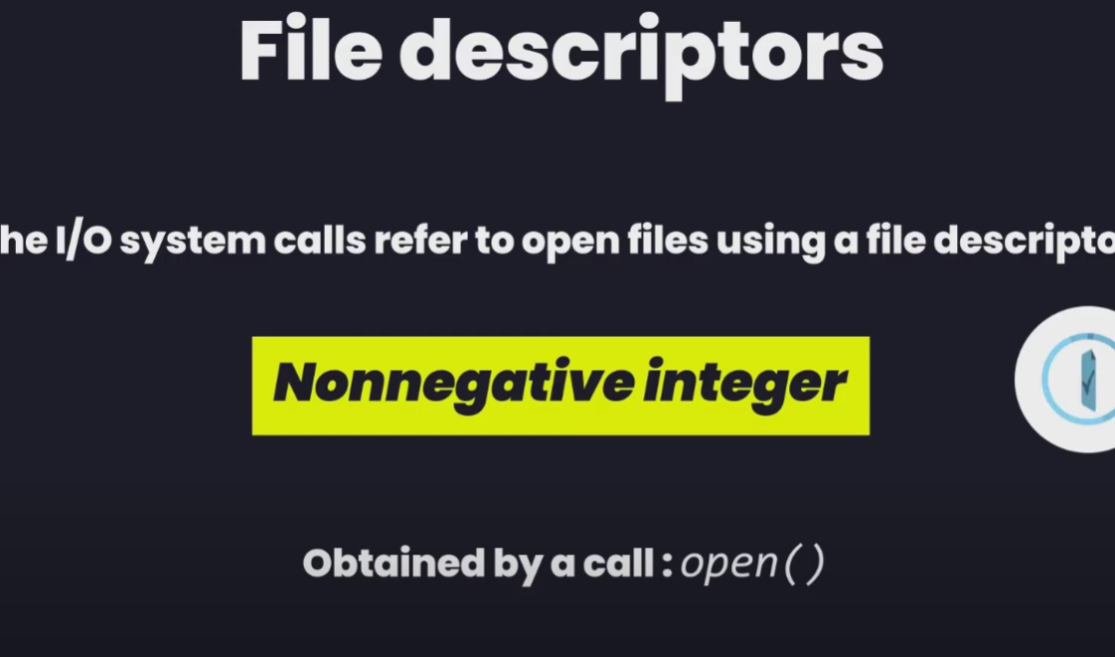
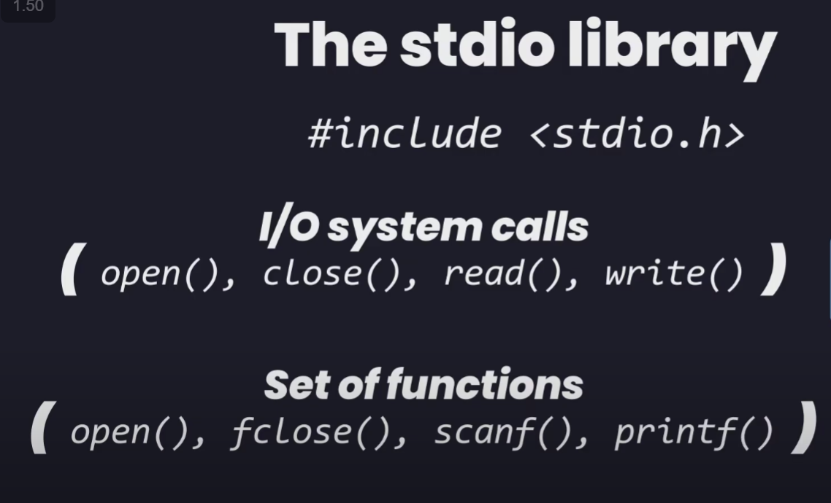
File I/O model

Slide 12
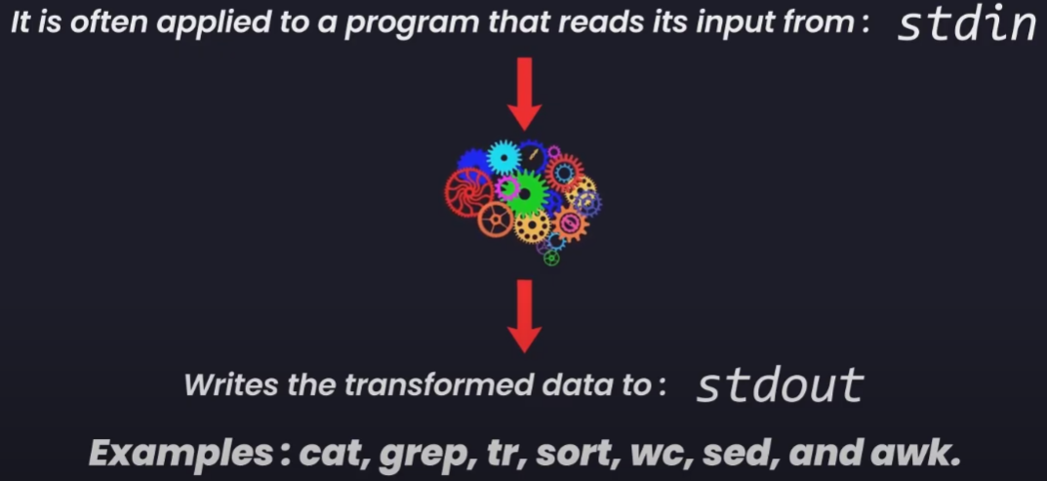
Programs
Source code in case of linux is C. which converted to binary machine code
Filters:

Slide 13
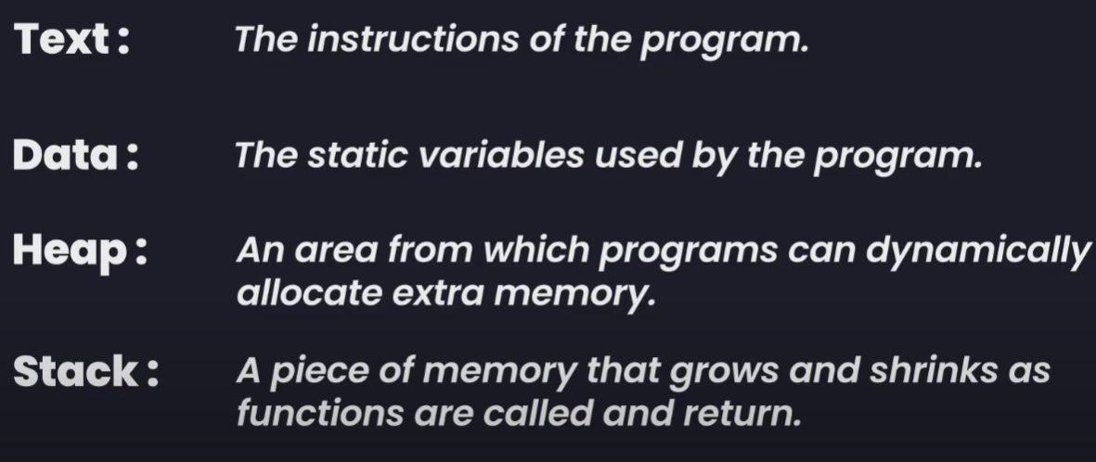
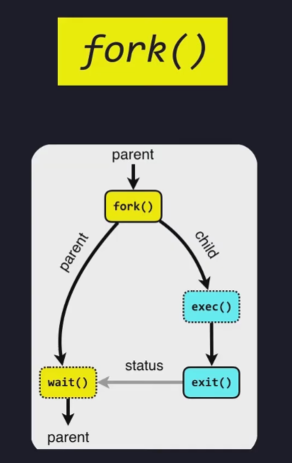
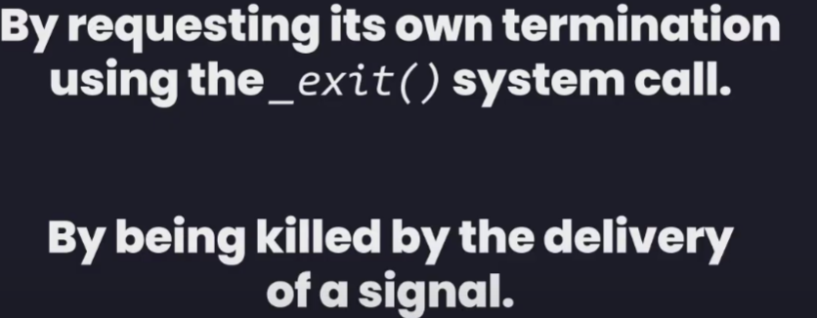
Process
Process memory layout divided into segments:
Process creation and program execution
(Pid – process identifier , ppid – parent pid)
Process termination:

Slide 14
Types of process
1. Init – parent of all processes
When booting system kernel creates special process
All the process are created by the fork call by init process or its descendent
2. Daemon
~It is long-lived - Starts at system boot and remains in existence until the system is shut down.
~It runs in the background - It has no controlling terminal from which it can read input or to which it can write output.

Slide 15
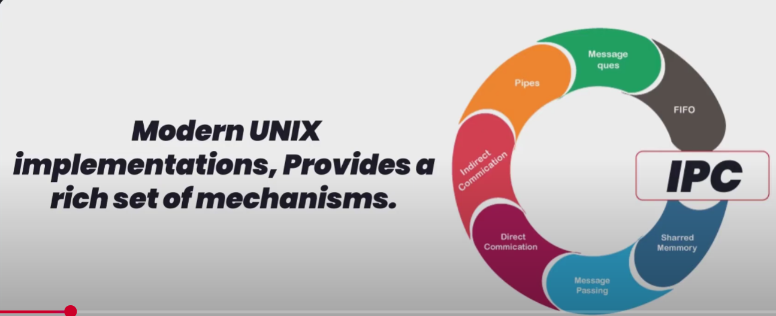
Inter process comm(ipc) & isolation
Inter process communication is generally done through writing/reading data from hard disk files – which is slow.
So for ipc, unix has rich mechanism – it has signals, pipes, sockets, file locking, message queries, semaphore, shared memory

Slide 16
Signals
Software interrupts – some event or exceptional event occurred.
Each signal type identified by integer, SIGxxxx – tells type of signal, can be send to process by process itself or kernel.
Kernel may send a signal to a process while one of the event occur for e.g:
User typed ctrl + c – interrupt, one of the child process terminated, time of process has expired signal is sent, process trying to access invalid memory

Slide 17
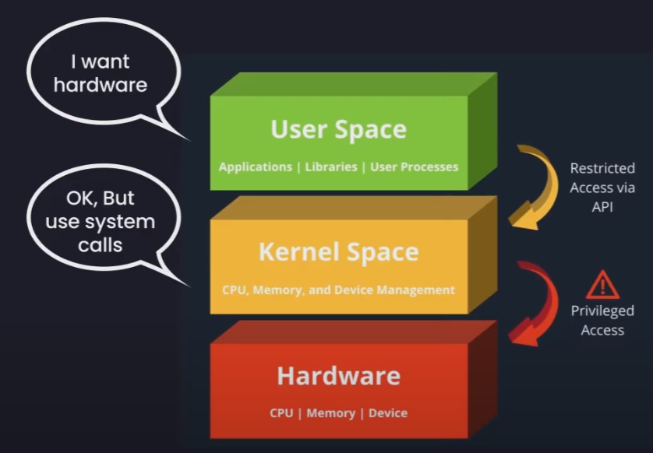
User mode vs Kernel Mode
The main feature of the Linux operating system is to provide security and accessibility to the underlying hardware.(we don’t want any app. To mess with our hardware)
There are some processes that require hardware control, like user input require I/O devices.

Slide 18
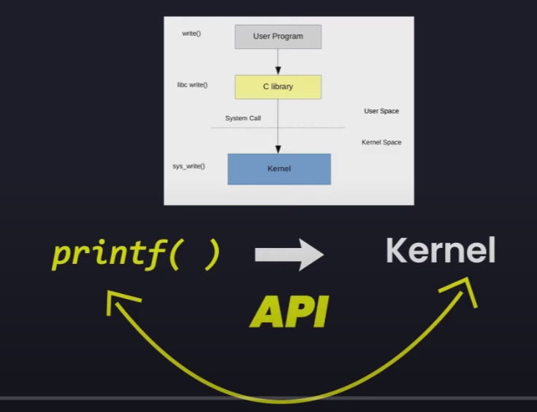
Library function, execution of c program, System call
1. Library func – multitude of inbuilt function in c programming.
St. c library is in #include<libc.h>. There are different variations of c library functions(stdoi.h,etc), most common used is glibc in unix.
Glibc – contains multiple function some of them which may not use system calls, but there are some library functions which are layered on top of system calls.
E.g – fopen() – open up a file function in C , but in backend based on system call open()
2. Touch demo.c, gcc demo.c(source file) –o demo(object file) -> runs program, ./demo –> (output file)
3. System call – a controlled entry point into the kernel level. It is like API. Allowing process to req to kernel so that it performs some action on process behalf.
E.g: printf() in c -> write() system call is called -> process asked kernel to write on behalf of process.
Kernel makes a range of services available for programs through the system call.
Now the services to prog through the system call api include:
e.g: Creating a new process, Performing I/oCreating, pipes for IPC
System call changes the process state from user mode to kernel mode so that it can access the protected kernel memory.

Slide 19
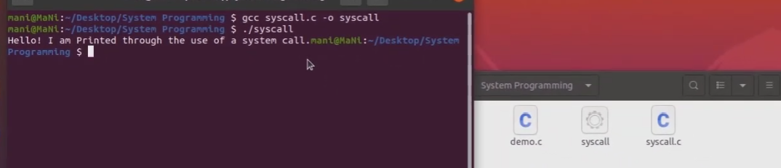
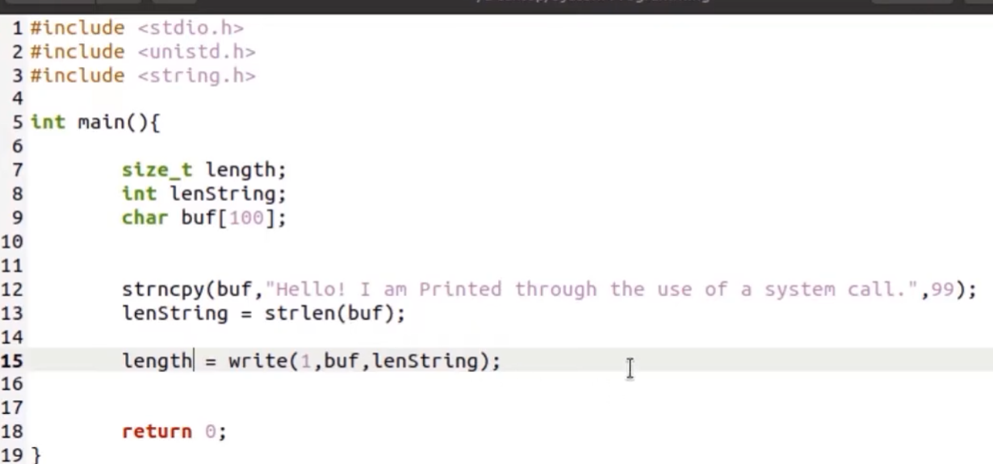
Ex: of system calls
Invoking a system call is like invoking a normal c function. We executed using a system call write(), instead of standard c library function.

Slide 20
Files I/O operation
Using FDs
rwx – read(4), write(2), execute(1). e.g - 6 –> rw_, 7 -> rwx, 5 -> r_x, 3 -> _wx – in sys call function we can mention (study later)
In linux os everything is considered as file.
Note: "-": Regular file (data files), "d":Directory, "c" : Character device file,"b": Block device file, "s": Local socket file, "p": Named pipe, "I" : Symbolic link
E.g: -rwxrwxrwx (regular file), drwxrwxrwx(directory) [user, group, others]
Cmds example - chmod 777 demo , chmod 177 demo (for demo.c)

Slide 21
FD
All sys call performed refer to these fd.
Fd is non negative integer. Every process ahs its own fds.
3 st fds: - these are opened on behalf ofprog by shell even before the prog starts
1. stdin – 0
2. stdout – 1
3. stderr – 2

Slide 22
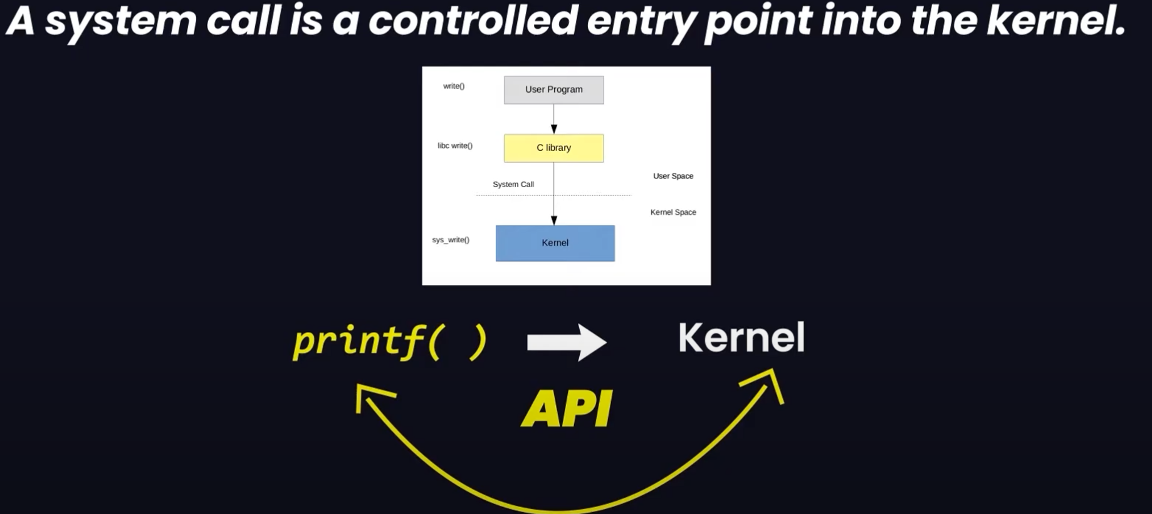

Sys call

Slide 23
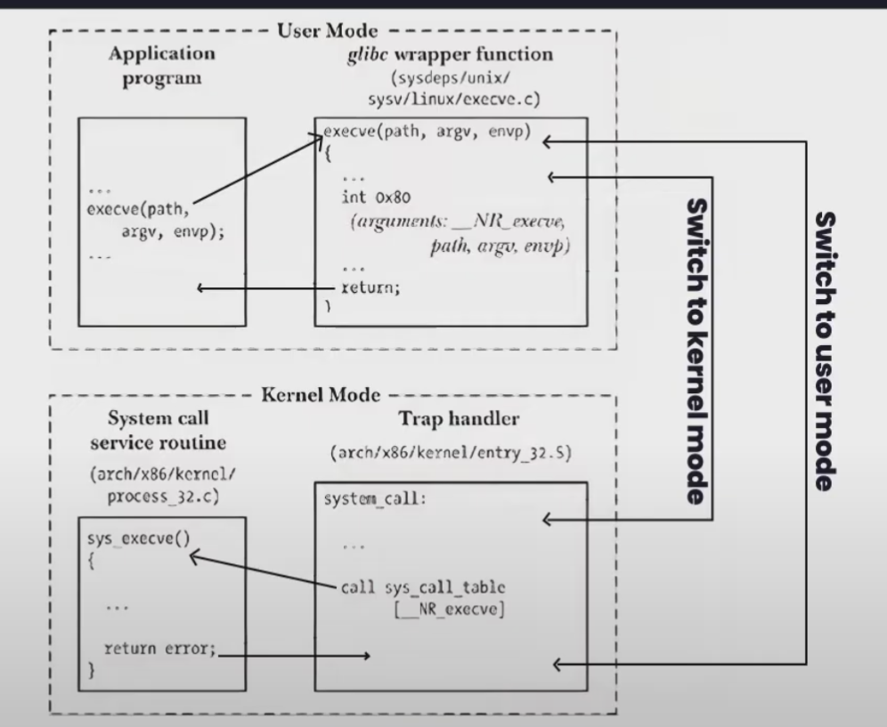
SYS CALL Working

Slide 24
Types pf Sys call
Open()
Read()
write()
Close()

Slide 25
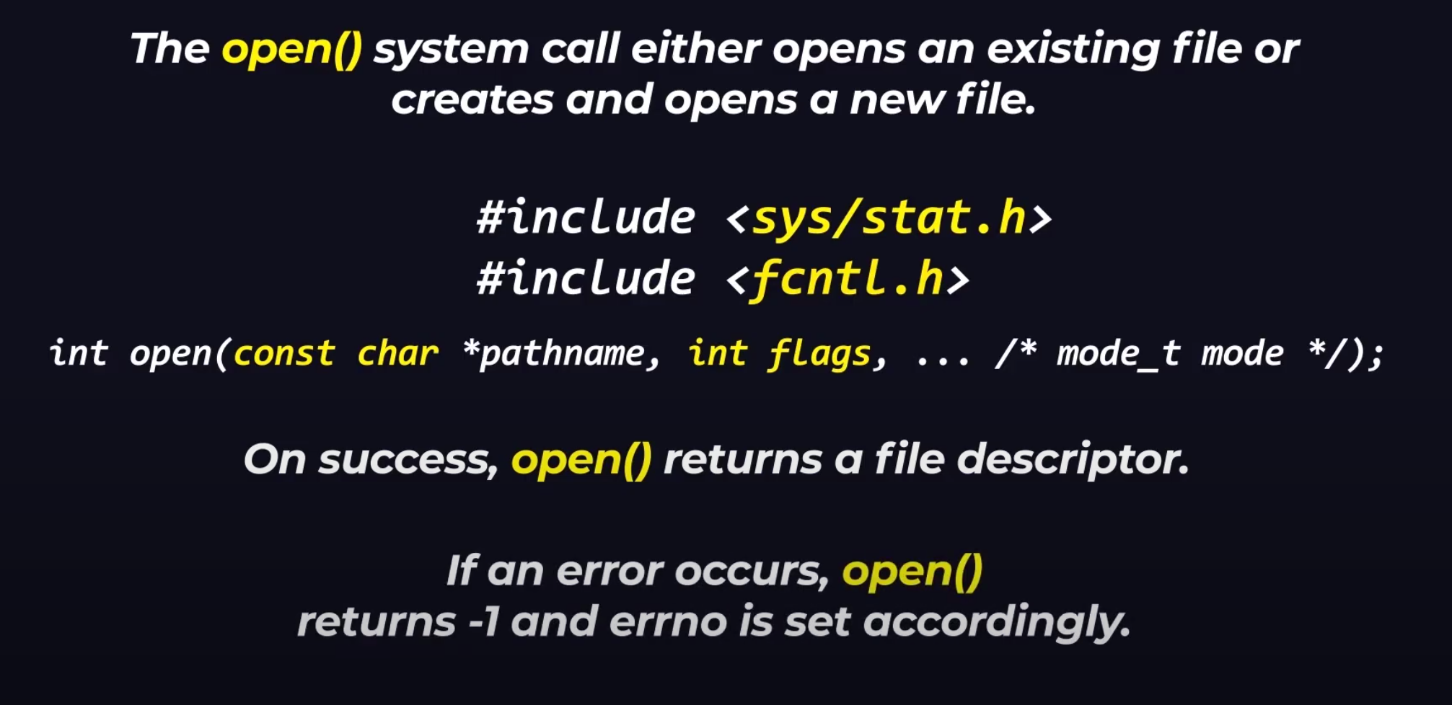

1. Open() – sys call (returns int)

Slide 26
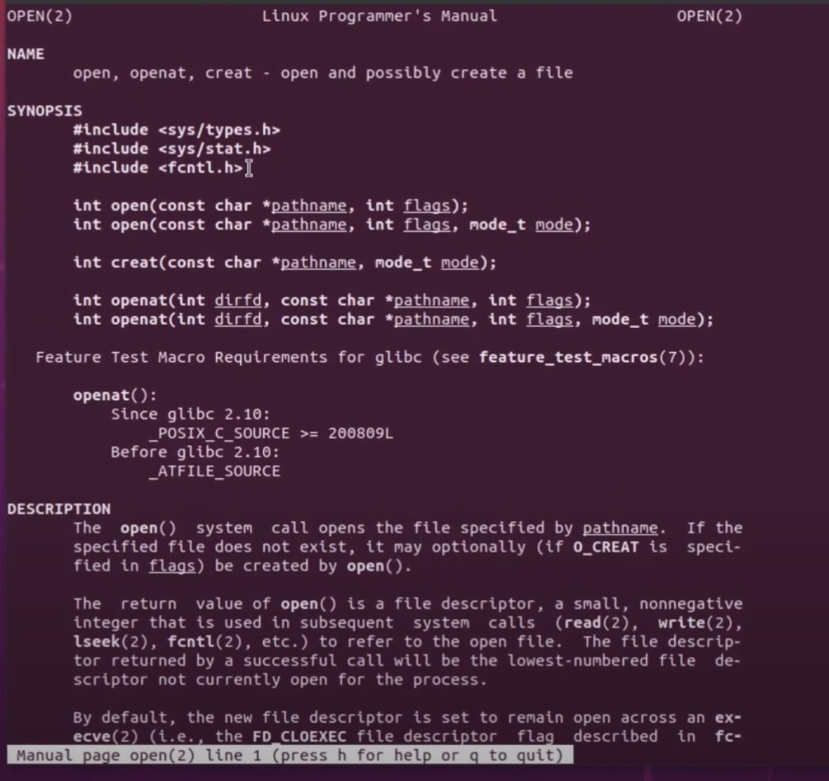
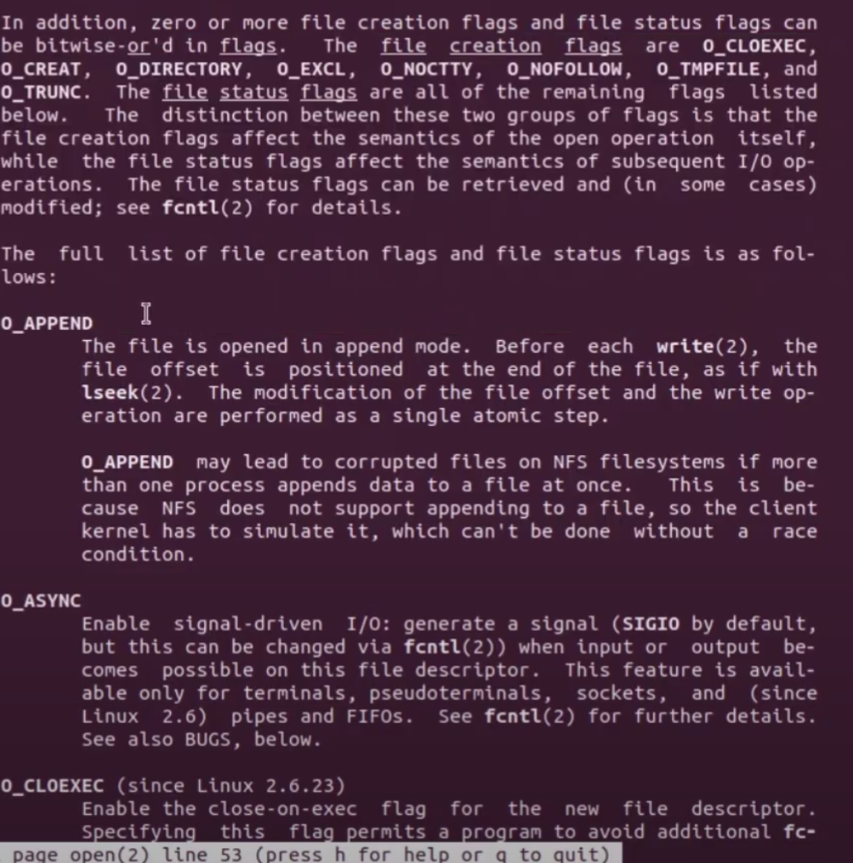
Manual - Man 2 open – write in terminal to open manual for open sys call

Slide 27
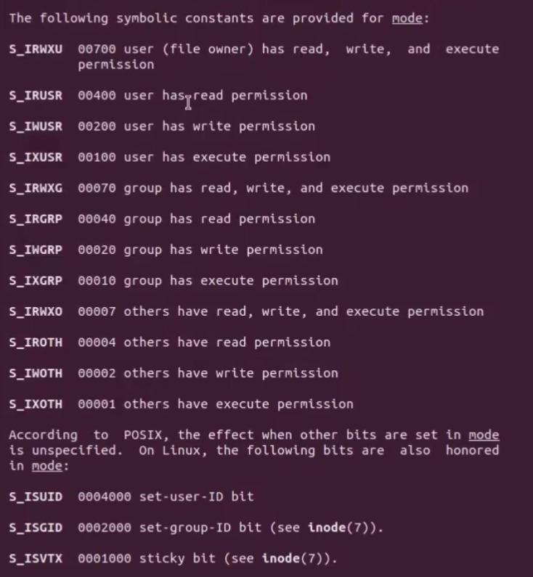
manual

Slide 28
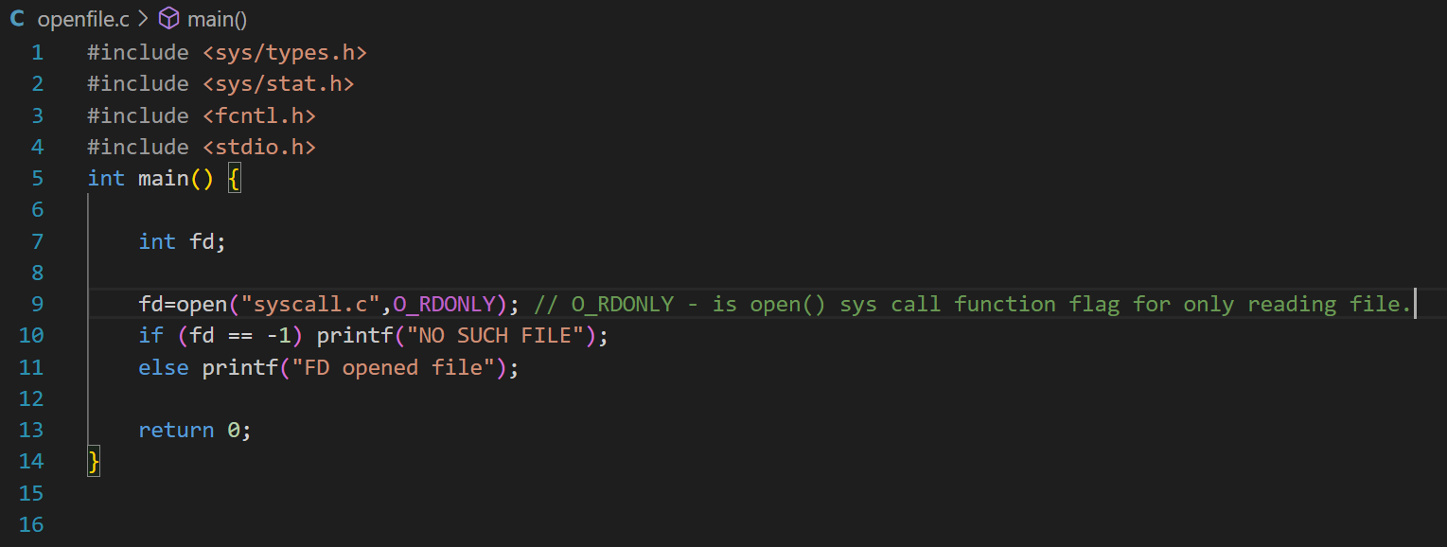
Open() – open an existing file

Slide 29
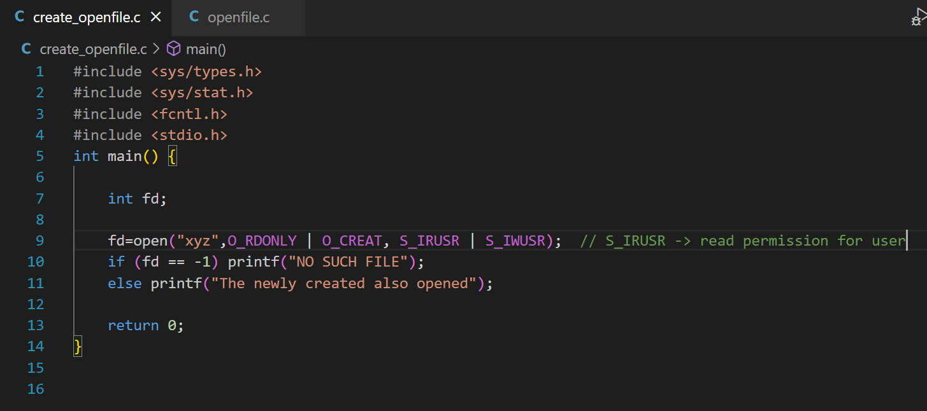
Open() – create and open file.

Slide 30
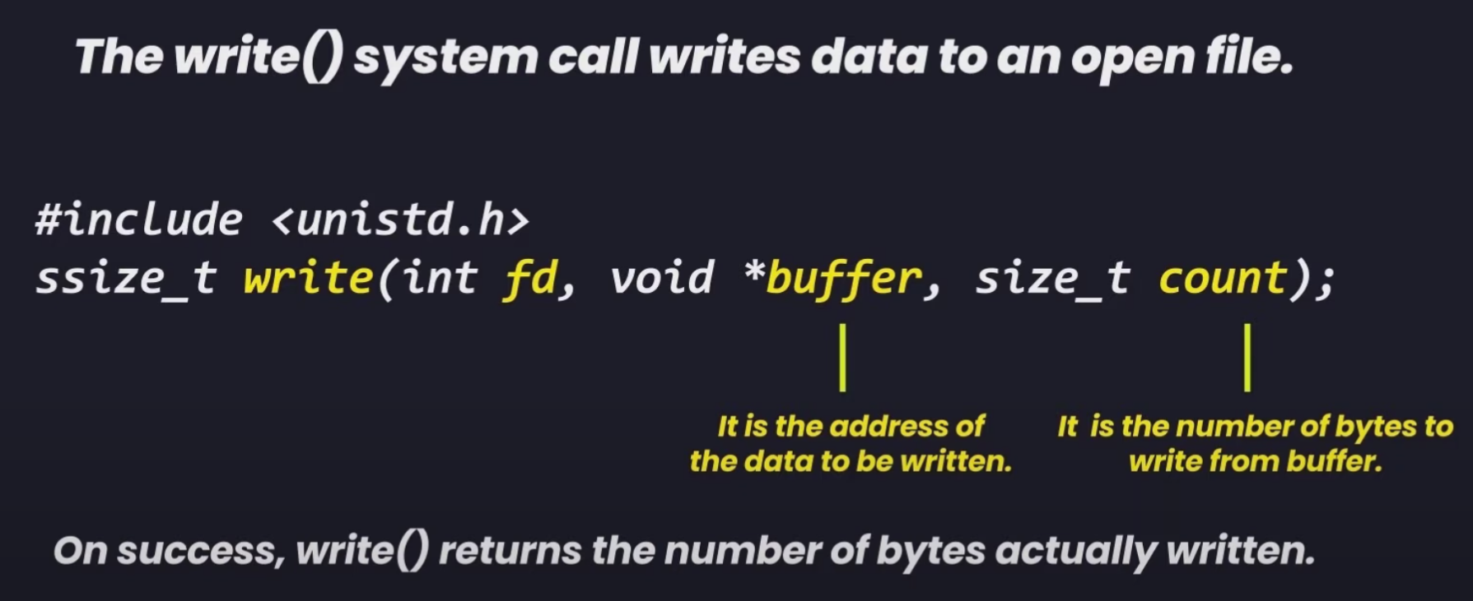
2. Write()
Return ssize_t datatype, note: writes on an open file

Slide 31
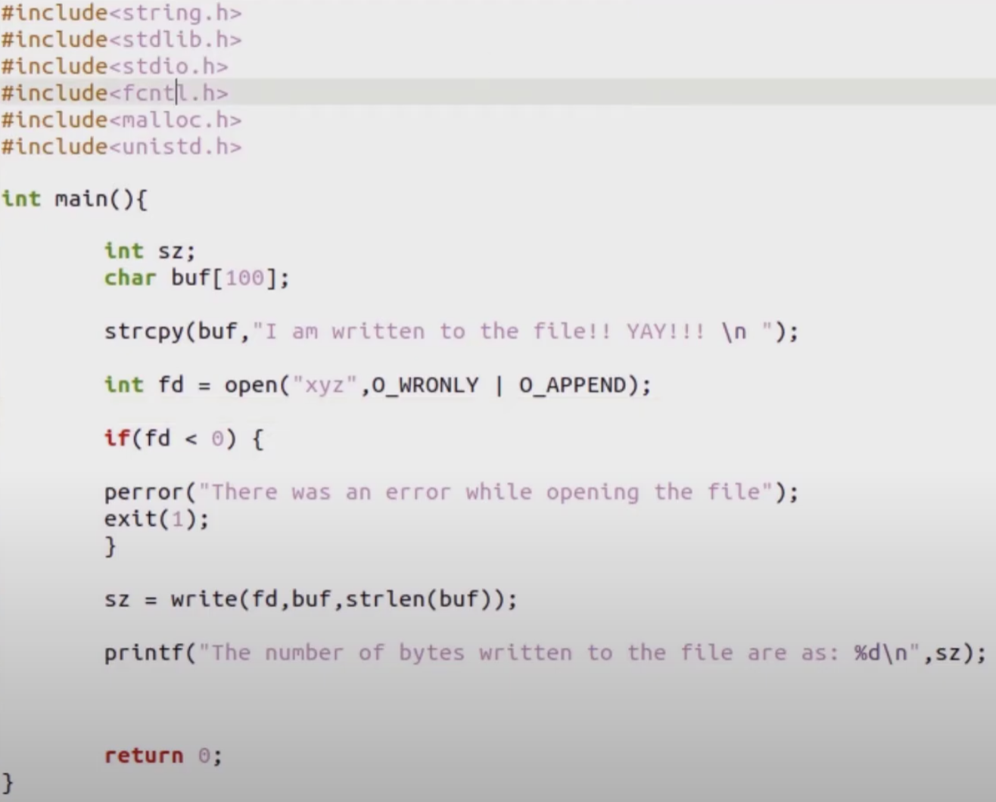

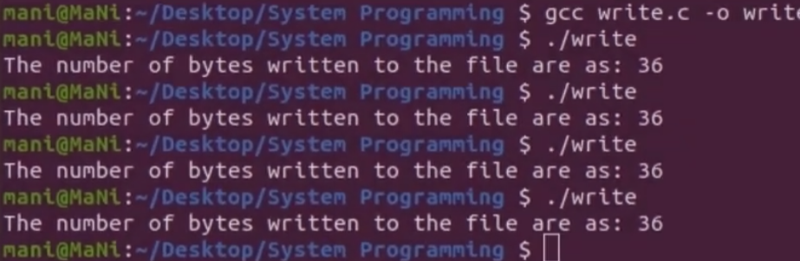
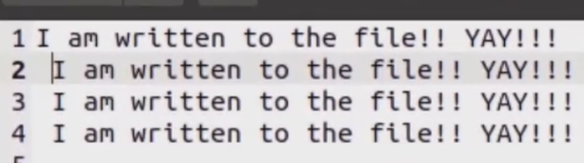
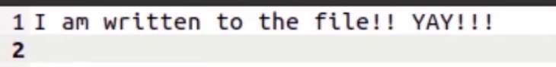
Code with append(keeps prev data and appends new one) and truncate(removes all and adds new line), here int used but should use ssize_t ->

Slide 32
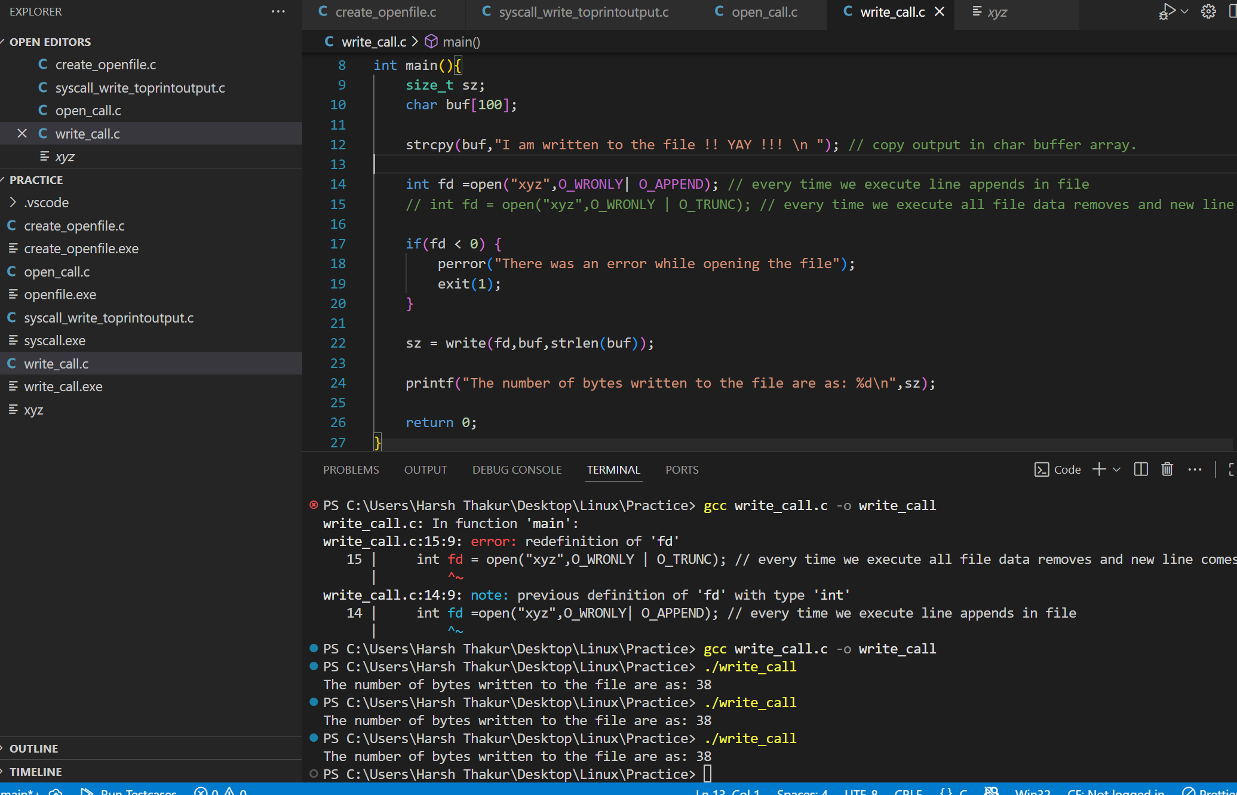
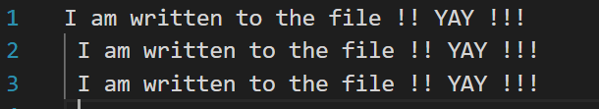
In vs code write() call execution – ssize_t
Mistake: It should be ssize_t instead os size_t as later it may through error.
size_t will compile and run (that’s why your code didn’t crash).
But it’s wrong semantically: it hides error values (-1).
Correct type = ssize_t.
size_t is unsigned → can’t represent -1.
int is signed, but on 64-bit systems int is 32 bits while ssize_t is 64 bits.

Slide 33
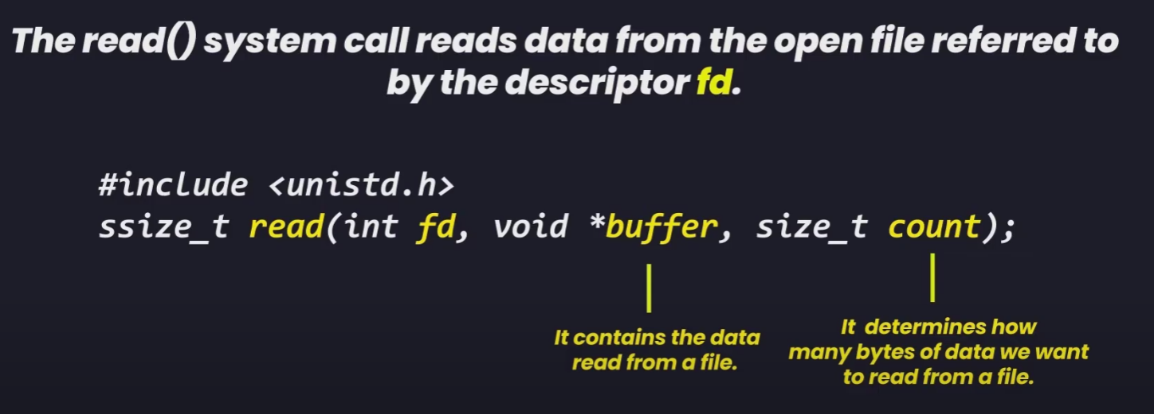
3. Read() – ssize_t

Slide 34
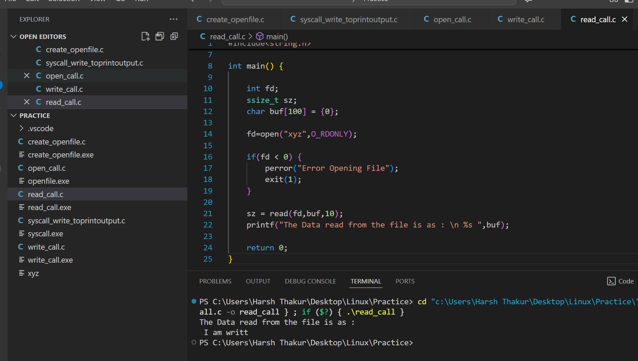
Read() – first 10 bytes of the file

Slide 35
Read flow:
1. File Descriptor (fd)
fd = open("xyz", O_RDONLY);
open() asks the kernel to open the file xyz.
The kernel checks the filesystem, finds the file’s inode, prepares it for reading, and creates an entry in the kernel’s open file table.
Your program just gets back a small integer (e.g., fd = 3).
0 = stdin
1 = stdout
2 = stderr
3 = your first opened file
This integer is called a file descriptor (FD), basically a handle you use when talking to the kernel about that file.
2. Reading Data with read()
sz = read(fd, buf, 10);
What happens here:
Kernel looks at fd = 3 and finds the corresponding file in its table.
It sees you requested 10 bytes.
It copies up to 10 bytes from the file on disk into your memory (buf).
It updates the file’s offset (like a cursor) inside the kernel, so the next read() will continue after those 10 bytes.
It returns the number of bytes actually read into sz.
3. What sz stores
sz = number of bytes actually read.
If the file has ≥ 10 bytes → sz = 10.
If the file has fewer (say 6) → sz = 6.
If file is empty or end-of-file reached → sz = 0.
On error → sz = -1.

Slide 36
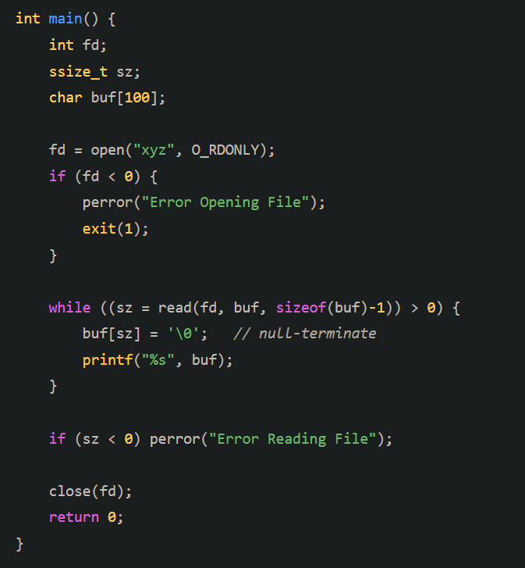
What actually happens in read()
If the file has more than 99 bytes left, the kernel gives you 99 bytes.
If fewer remain, you only get what’s left (maybe 20, maybe 0).
Each call advances the file offset, so the next read() picks up where the last one stopped.
So in your loop, you’re reading:
99 bytes into buf
Append '\0' → buf[sz] = '\0';
Print it as a string
Repeat until read() returns 0 (EOF).
read() copies exactly sz bytes from the file into buf.
It does not add a '\0' at the end, because it doesn’t know you want to treat the data as a string — it could be binary data too.
buf = [H][e][l][l][o][W][o][r][l][d]['\0']

Slide 37
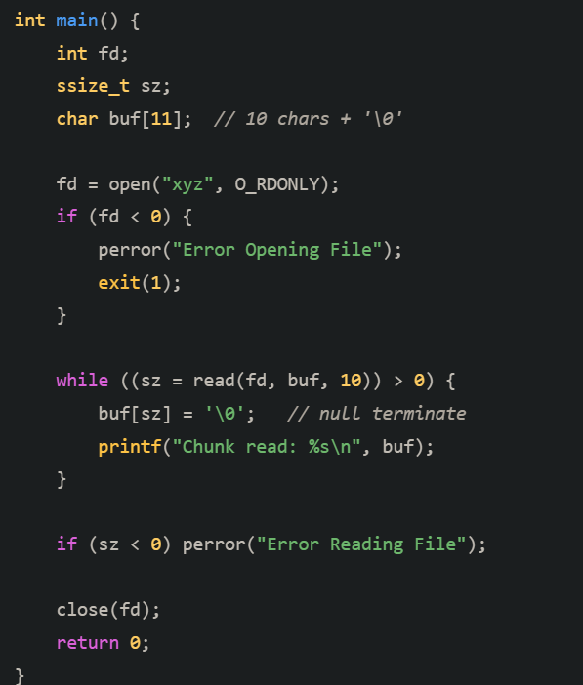
Reaching EOF while reading.
1. Why do we need '\0'?
In C, a string is just an array of char ending with a special null character '\0'.
Example: "Hello" in memory is actually:
[H][e][l][l][o]['\0']
The %s format specifier in printf keeps printing characters until it finds '\0'.
If no '\0' exists, it keeps going into random memory → undefined behavior.

Slide 38
Note: Why buffer ≥ count is necessary
Let’s break it down with the write() system call (same logic applies to read()):
1. Function signature
ssize_t write(int fd, const void *buf, size_t count);
buf → pointer to the data in memory.
count → number of bytes you are asking the kernel to write from buf.
2. What happens internally
When you call write(fd, buf, count):
The kernel will copy exactly count bytes starting at buf into the file/socket/device.
It doesn’t know or care how big your buffer actually is — it just trusts you.
3. Why buffer ≥ count is necessary
If your buffer is smaller than count, then the kernel will read past the end of your buffer while trying to access count bytes.
This is undefined behavior:
Could overwrite random memory.
Could crash with a segmentation fault.
Could silently corrupt data.
For example:
char buf[5] = "Hi"; // only 5 bytes allocated
write(fd, buf, 100); // asks kernel to read 100 bytes from buf
Here, kernel will happily try to read 100 bytes starting at buf, but your buffer only has 5 bytes. → Memory violation risk 🚨.
4. Safe rule
Always make sure:
buffer size (allocated memory) >= count (number of bytes you pass)
Typically we do:
size_t count = strlen(buf);
write(fd, buf, count);
5. Extra note
In read(fd, buf, count) → the opposite happens:
Kernel will try to put up to count bytes into buf.
If buf is smaller → buffer overflow risk.
✅ That’s why buffer size ≥ count is mandatory: It ensures that kernel won’t touch memory outside your valid allocation.

Slide 39
This phrase “file/socket/device” comes up a lot in system calls like open(), read(), write(), etc. Let’s break it down clearly:
1. In Unix/Linux: Everything is a file
The kernel provides a uniform interface: files, sockets, pipes, devices all look like “files” to user programs.
You interact with them using the same system calls: open(), read(), write(), close().
So the word “file” here is abstract — it doesn’t only mean a text file on disk.
2. File
A regular file stored on disk. Example:
int fd = open("notes.txt", O_WRONLY);
write(fd, "Hello", 5);
Data goes to your hard drive/SSD.
3. Socket
A communication endpoint used in networking (TCP, UDP).
You can read() and write() to a socket just like a file, but instead of going to disk, the bytes travel across the network. Example:
int sockfd = socket(AF_INET, SOCK_STREAM, 0);
write(sockfd, "GET / HTTP/1.1\r\n\r\n", 18);
This sends data over the internet.
4. Device
Hardware devices are also exposed as “files” under /dev/.
Example: /dev/tty (your terminal), /dev/sda (disk), /dev/random (random number generator).
Writing to /dev/tty → prints to your screen.
Reading from /dev/random → gives random bytes.
5. Why this design?
This is the Unix philosophy:
“Everything is a file.”
It makes programming easier — the same read()/write() calls work for:
Disk files
Network sockets
Terminals
Hardware devices
Pipes/FIFOs
✅ So when we say "write() writes to a file/socket/device", it means:
File → persistent storage
Socket → network communication
Device → hardware/OS interface

Slide 40
Printing format
1. Why (int)sz sometimes works
If you do:
printf("%d\n", (int)sz);
You’re forcing the 64-bit ssize_t into 32-bit int.
Works fine for small reads (like 10 bytes in your example).
But if sz > INT_MAX (≈2.1GB), it will truncate the value and print garbage.
So (int)sz is only safe for tiny buffers, not in general.
2. Correct way (no cast needed)
printf("%zd\n", sz); // portable: use %zd for ssize_t
Or if you want only the data:
printf("The Data read is: %.*s\n", (int)sz, buf);
Here %.*s takes sz as a length, then prints that many chars from buf. Casting to (int) here is fine, because you’ll never realistically print more than 2 billion characters to the screen anyway.

Slide 41
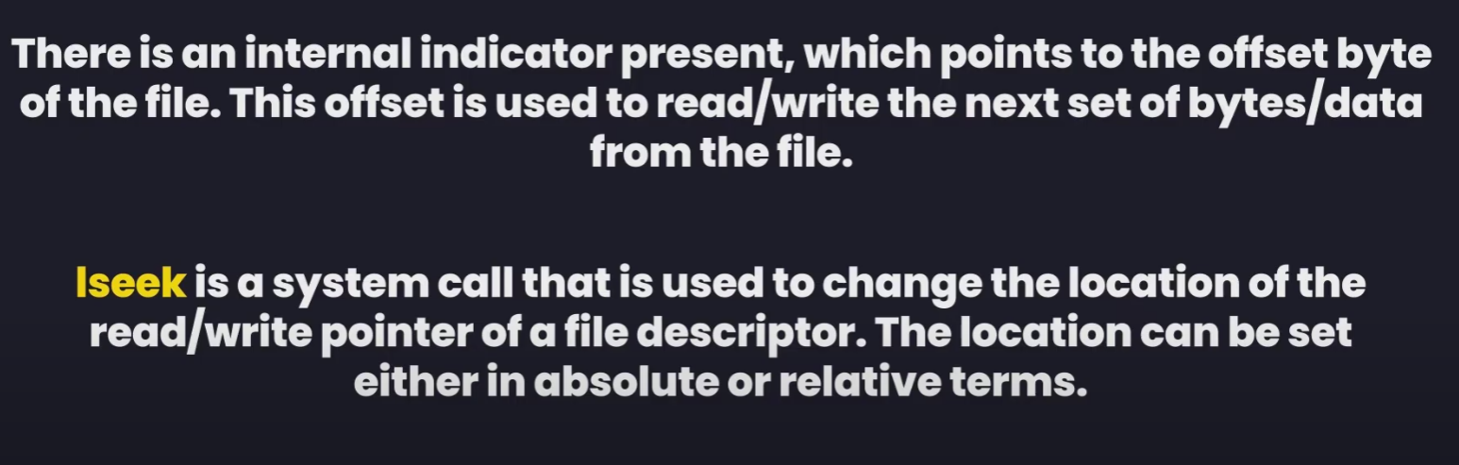
Lseek() sys call – to read next set of bytes from file.
#include<unistd.h>
off_t lseek(int fd, off_t offset, int whence) -> return datatype is off_t
off_t offset -> no. of bytes of the offset
Whence: predefined integer value 1.SEEK_SET -> used to change the pointer to point at start of the fill to the offset byte we give.
2.SEEK_CUR -> add no. of offset while maintain the curr pos
3.SEEK_END -> change pointer towards the end of the file

Slide 42
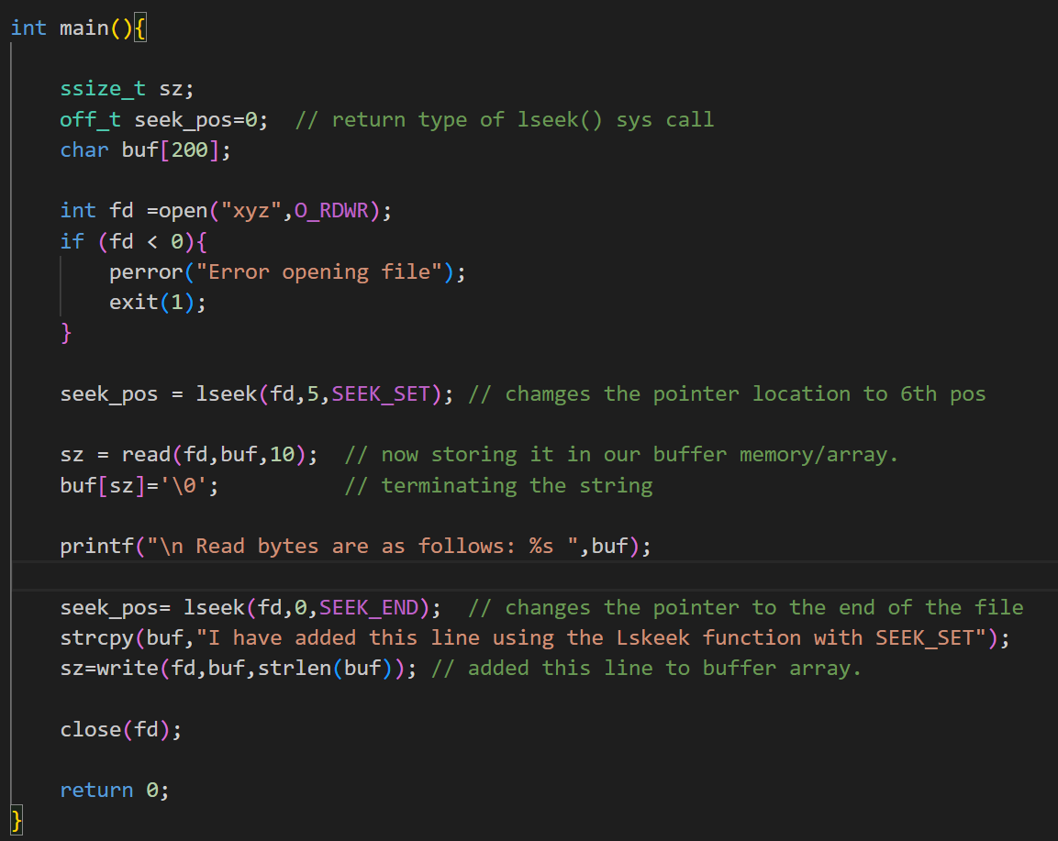
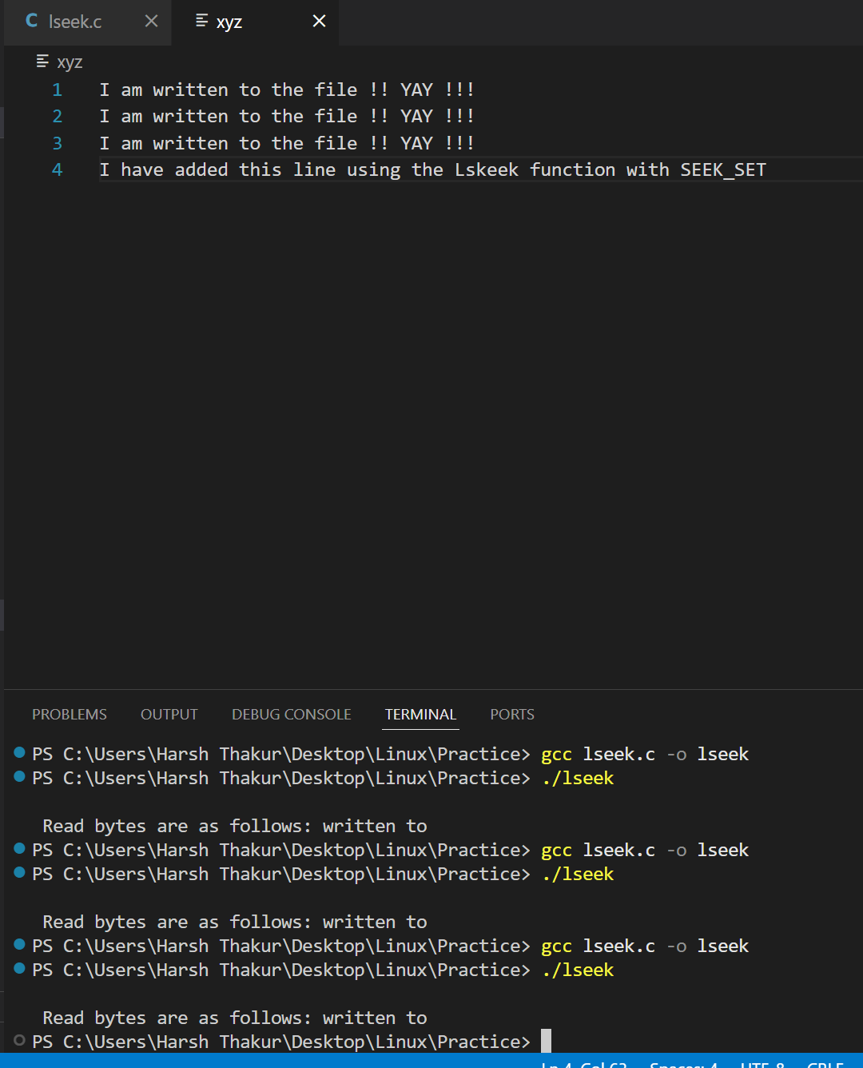
Lseek with SEEK_SET
1. lseek(fd,5,SEEK_SET) -> this will put the cursor to the 6th position in the file and will read from there.
2. What happens in lseek(fd, 0, SEEK_END)
whence = SEEK_END → measure offset from the end of file.
offset = 0 → don’t move forward or backward, just stay exactly at the end.
3. If you change the offset
lseek(fd, 5, SEEK_END) → move 5 bytes after the end.
If you write now, the kernel fills the gap with \0 bytes (sparse file).
lseek(fd, -5, SEEK_END) → move to 5 bytes before the end.
Next read/write will happen starting there.

Slide 43
Race Condition
When 2 or more process tries to access a shared memory.
A race condition is a situation where the result produced by two processes (or threads)operating on shared resources depends in an unexpected way on the relative order in which the processes gain access to the CPU(s).
For example, If we are running two programs and both Programs try to make the same file(log.txt). So, In this case where the file does not exist and when we try to run both of those programs simultaneously, both of those processes would result in saying that we have created the program but we won't know which was the process that actually created that particular file. Thus results are unpredictable.
So multiple process are racing with each other to access a shared memory. Resource scheduler is actually failing to give a process a particular time to execute and then moving the control to other process.

Slide 44
Atomicity in Linux or system programming – to avoid race cond.
1.Atomicity is a condition in which the code is written in such a way that code cannot be run by other process/thread 'AT SAME TIME' while it is being executed/running by first process/thread.
2.When first process completes the execution and tells the kernel that it has completed and then the kernel would give access to the process no. 2 to the shared memory resource
3.All system calls in Linux are executed atomically.The kernel guarantees that all of the steps in a system call are completed as a single operation.(no intermediate results).
The atmocity is imp. To maintain in multi-processing env. Like a linux system else race condition may occur.
4. By restricted access to the processes by the kernel we can achieve Atomicity

Slide 45
Process
A running execution of program is known process.
Whatever we code in our c file is source code. This source code is converted to object file by pre processor and convertor.
After compiling the object file the linker links the header files with the program.
Program is complied along with the lib and converted to excutable format. A.c file – source code and executable file ‘A’ which when executed is considered as process.
a prog is a process while its executing within the memory, after that it terminates.

Slide 46
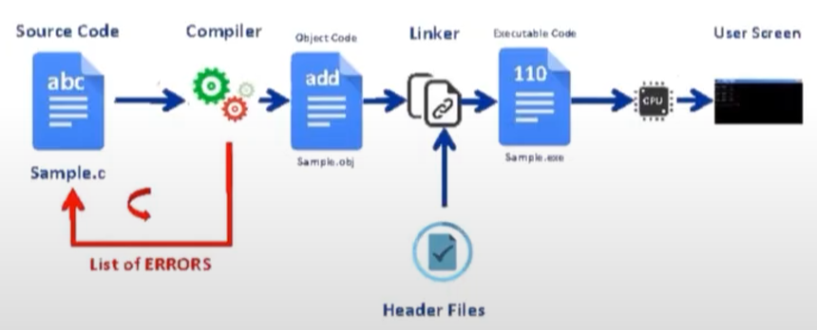

Slide 47
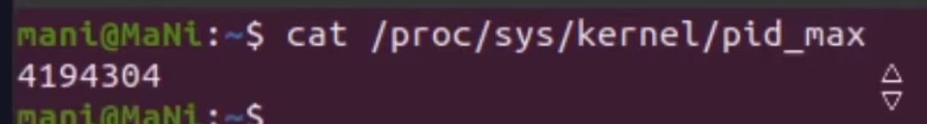
PID and PPID
Parent child relation.
When linux starts – Process 0 (Swapper process)
Process 1 – init process:
When parent process terminates (child becomes orphan) then parent of the orphan process is init process
Ps –ef – to see all the processes
To se no. of processes

Slide 48
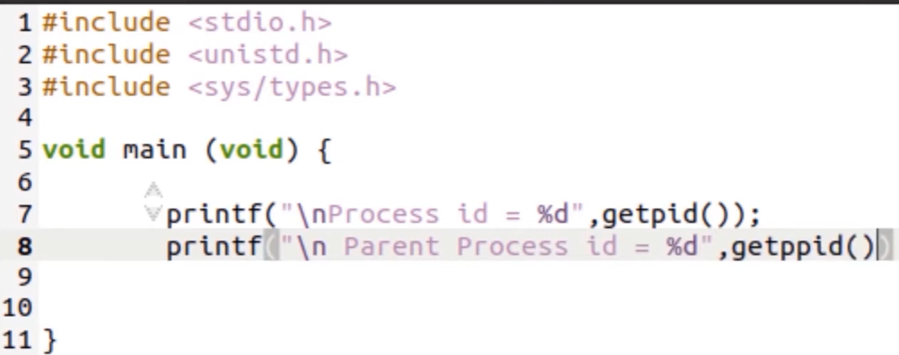
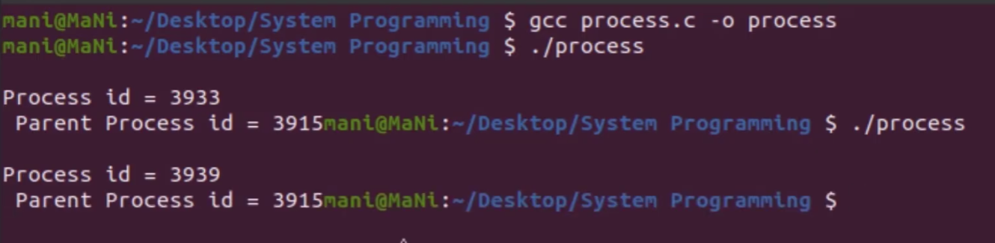
Getpid()
Parent id – id of the particular terminal or the shell that executed the cmd.
So if we re run we will get diff pid from kernel but same ppid.

Slide 49
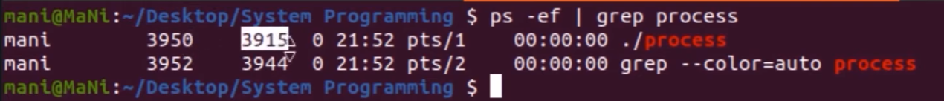
Grep process → filters that input and prints only the lines that contain the string "process".

Slide 50
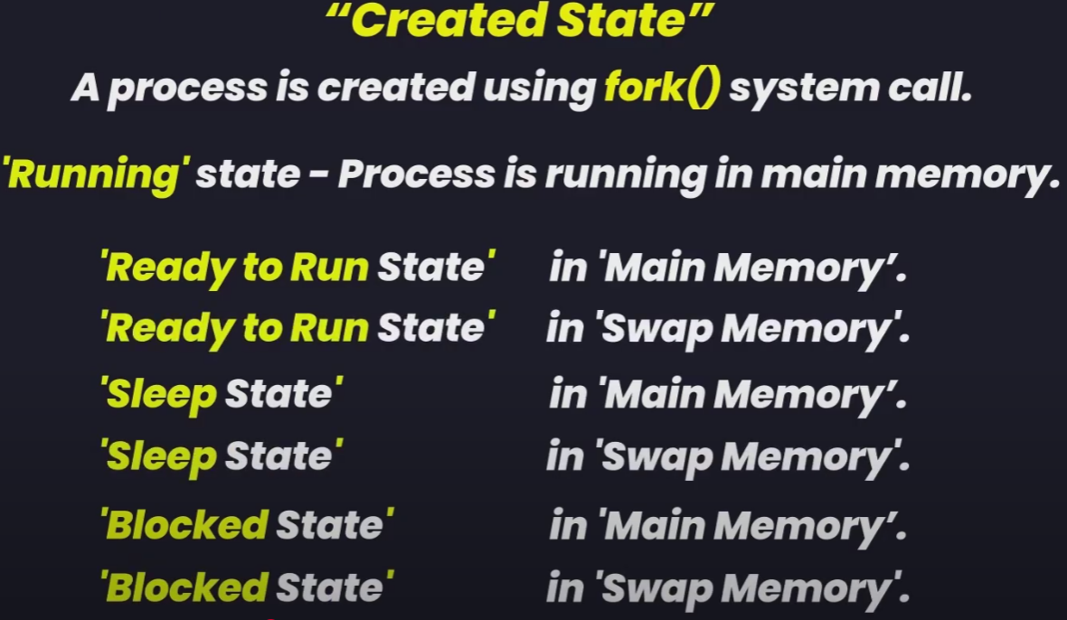
Process State
Swapper can swap process out of the main memory

Slide 51
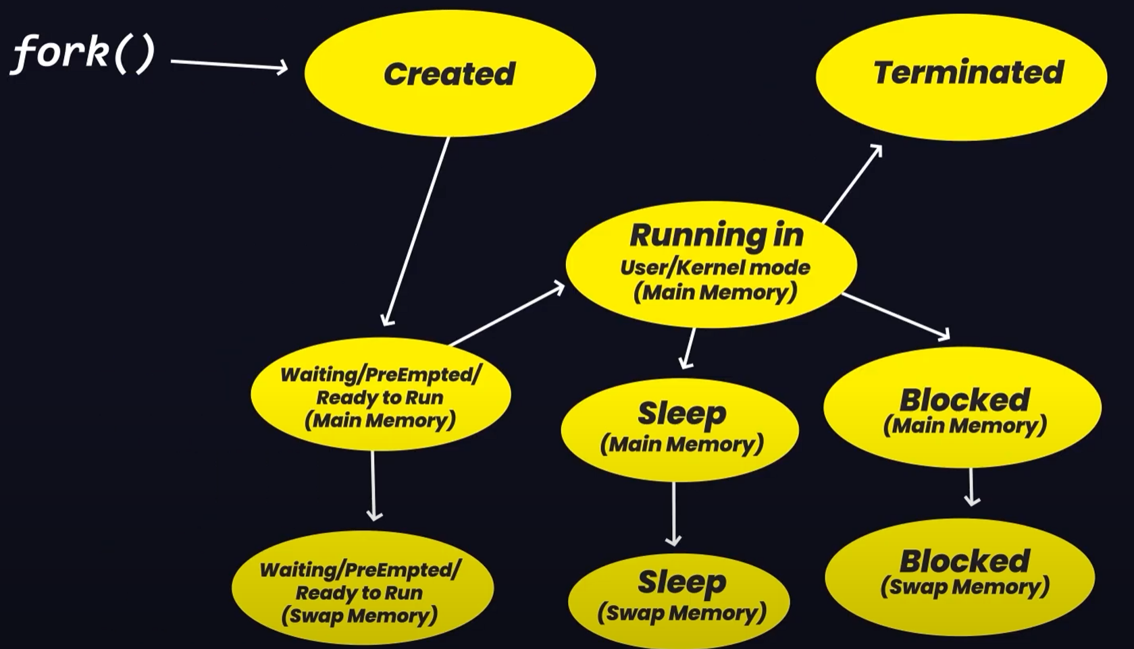
Process state
Ready to run – process has acquired all the resources for process execution and when the scheduler
gives some cpu time for this process, process moves from waiting to running state in main memory.
Now it goes to blocked(if resource si being used by another processs) or sleep(if process executes sleep())
State.
All this in main memory, but we need for other process also. so swapper swaps out process from main
memory. And after that process terminates

Slide 52
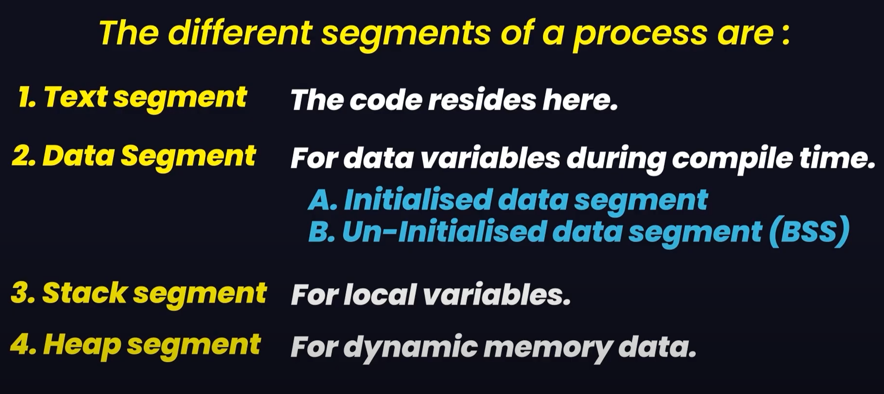
Process Memory Layout

Slide 53
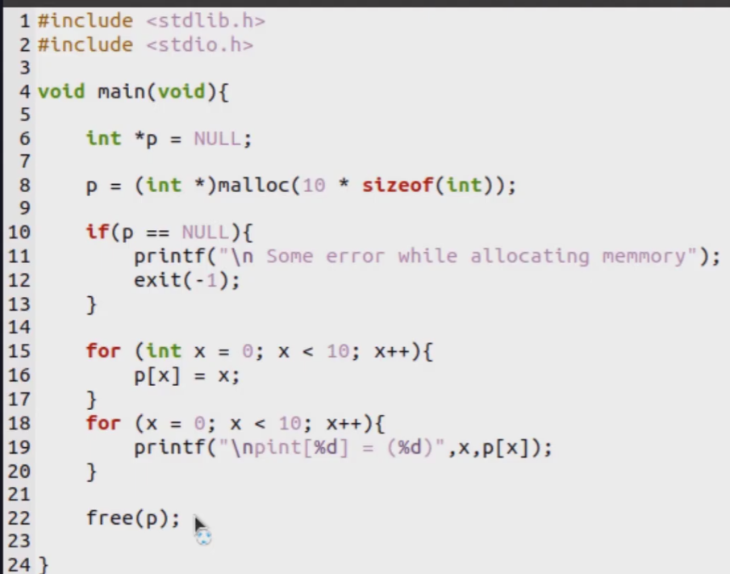
Malloc & Calloc – dynamic memory allocation in linux
Malloc – assign particular amount of memory to a pointer variable and fills that memory with garbage value. (total no. of memory it want – argument)
Calloc – same purpose but initialize memory with 0’s. ( 2 argument – no. of memory location and size of each memory location like (int *)calloc(10, sizeof(int)) )

Slide 54
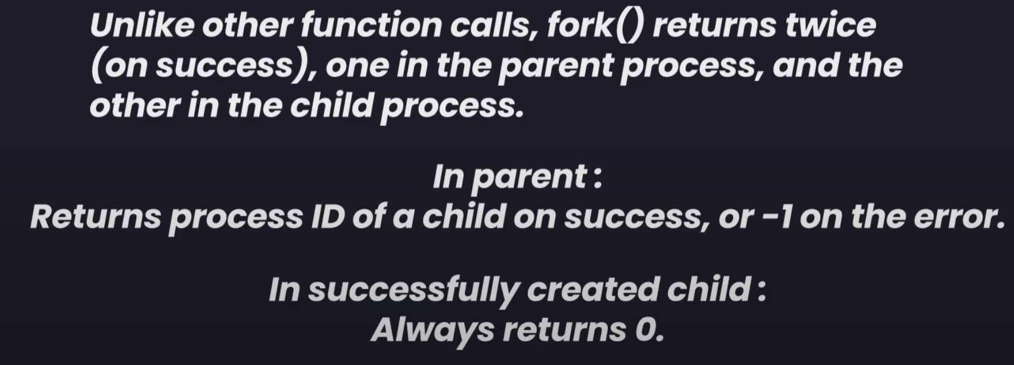

Fork()
Duplicate of parent and return type pid_t fork(void)
If inside parent process fork id >0
If id <0 – fork failed
If id == 0 – inside child process or virtual memory.

Slide 55



